Slide 1

Anand Sivaraman Subramaniam
Data Inspired Techno Functional Leader & Data Science Coach
Possess Over 20+ years of IT industry Experience specializing in Data Analytics and Financial Services Domain
Passionate about teaching(learning) Data Science with a bias towards “learning by doing”
Trained over 500 plus learners (online and off) across the fields of Data Science and Financial Services.
Post Grad Diploma in Business Analytics and Business Intelligence
R and Python Certifications
Strong Skills in Statistics, Machine Learning, NLP, Reinforced Learning, ANN & CNN
Strong architecture skills on Big Data, Cloud, DW & ETL
Very good Data Visualization skills with Tableau
Certified Business Analyst
20+ years of Experience in Techno Functional Leadership both India and US
Ex VP and India Head for a global bank , leading Data Analytics Practice for Wealth Mgmt. line of Business
Start-up advisor and business strategist
Data Science Consultant and Coach
Head of AI practice for a Global IT Services org
Education
Experience
Conceived, Strategized and Built strong data driven teams
Led 100 plus million dollar Data Initiatives from India
Advised start-ups in technology and Business Strategy
Consulted MSME in building their lead management Strategy
Strong data focused domain expertise in Financial Services
Avid Speaker and Data Science Evangelist
Expert Functional and Technology in-house trainer providing several sessions on banking and various technologies
Over 11+ years of training experience in Data Analytics,
Conducted several sessions on Data Science with machine learning through R, Python
Conducted trainings on Data visualization with Tableau
Exposure
Training
Anand Sivaraman Subramaniam
Mentor and career counsellor for many budding data scientists , students and Technologist.
https://www.linkedin.com/in/anand-sivaraman-subramaniam-7982b5a/

Slide 2
Agenda
Era of Data Explosion
What is Data Science
Components of Data Science
Data Maturity in Organizations
The difference between Reporting/BI/Analytics
Introduction to a Data Science Project Life Cycle
Why Python?
Python Installation Steps
Pre work required before the classroom sessions

Slide 3
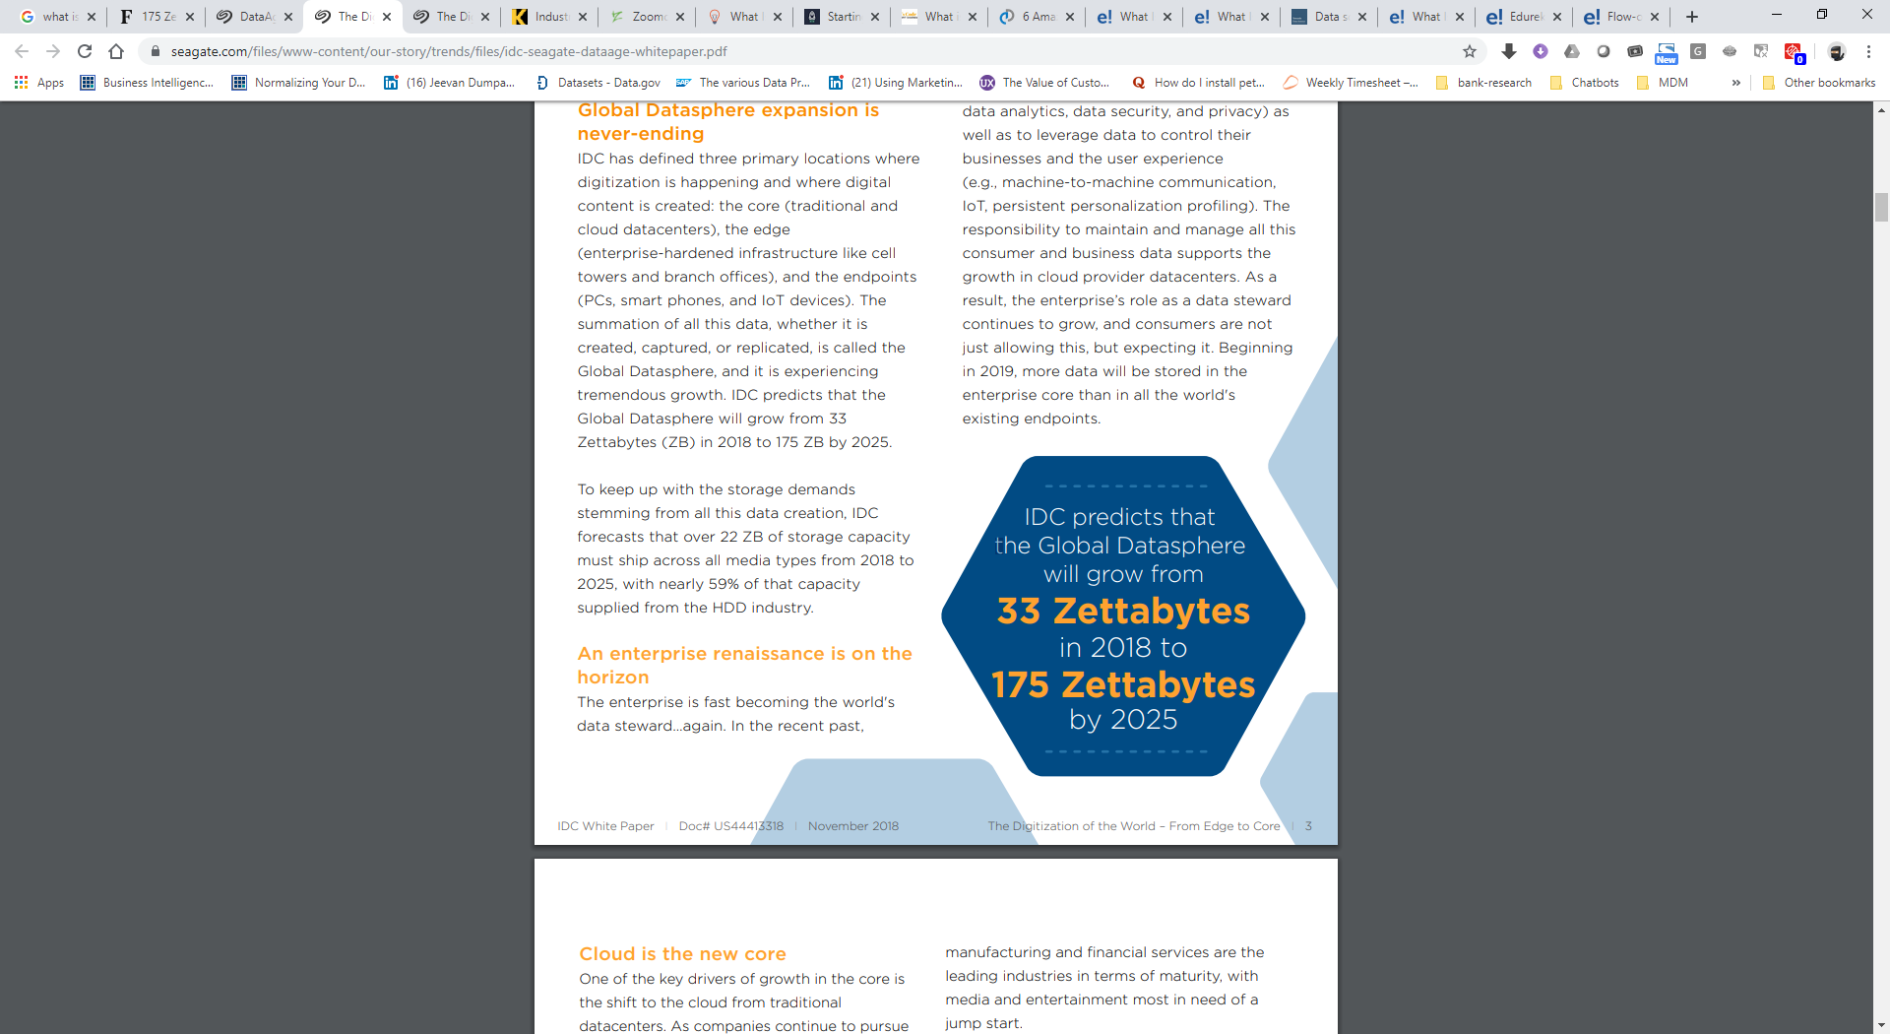
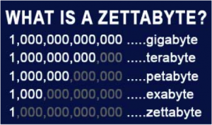
Data Explosion Era- A quick peek
https://www.seagate.com/files/www-content/our-story/trends/files/idc-seagate-dataage-whitepaper.pdf
IDC Forecasts Revenues for Big Data and Business Analytics Solutions Will Reach $189.1 Billion This Year with Double-Digit Annual Growth Through 2022
Demand for Data Scientists/ Engineers to Grow 40% by 2020; India Accounts <10% of Global Data Scientists

Slide 4
Cost of Bad or Dirty Data in Enterprises
Avg cost
9 – 15MM yearly
30% of revenue spend
Bad
Data
Avg cost
9 – 15MM yearly
World wide
Yearly spend USD 3 Trillion

Slide 5
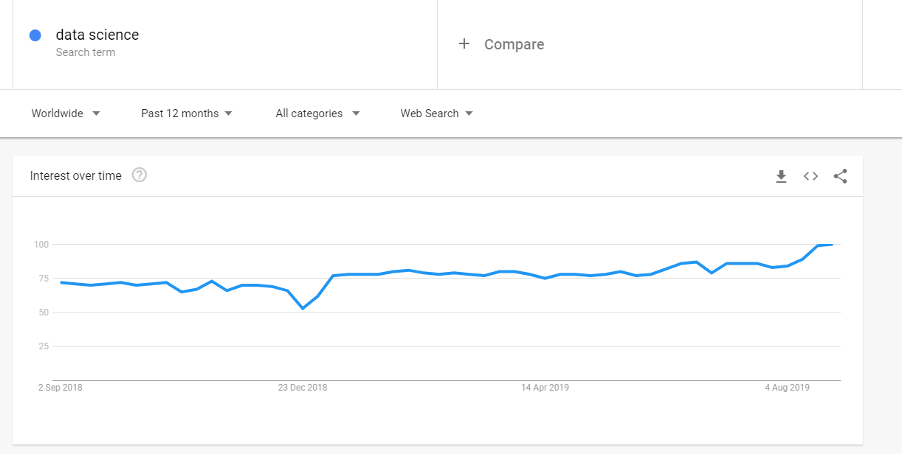
Data Science Trends

Slide 6
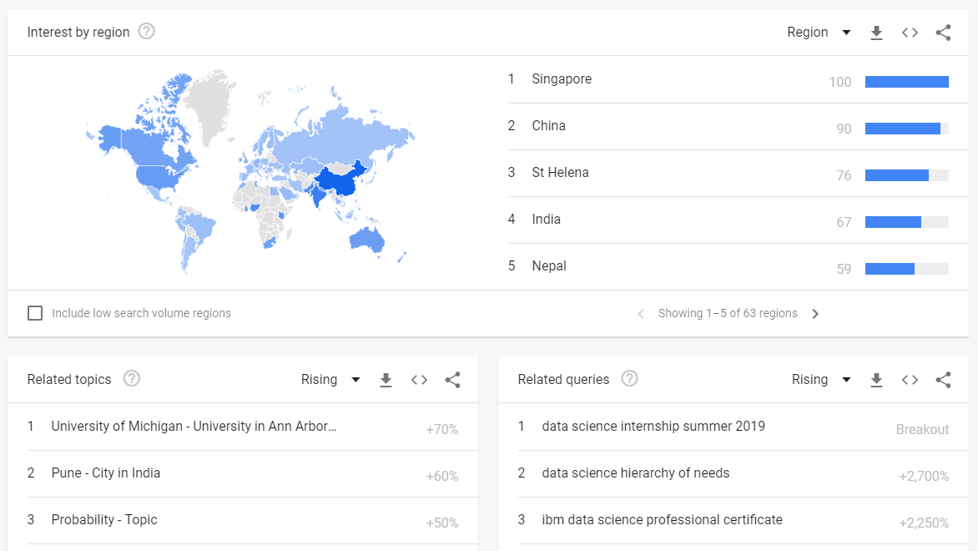
Data Science Trends – By Regions

Slide 7
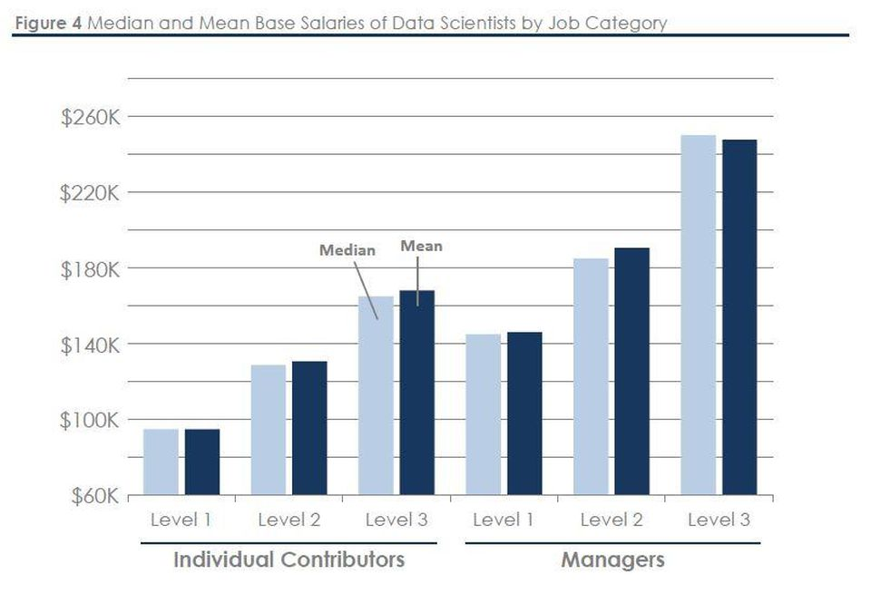
What do Data Scientist get paid?

Slide 8
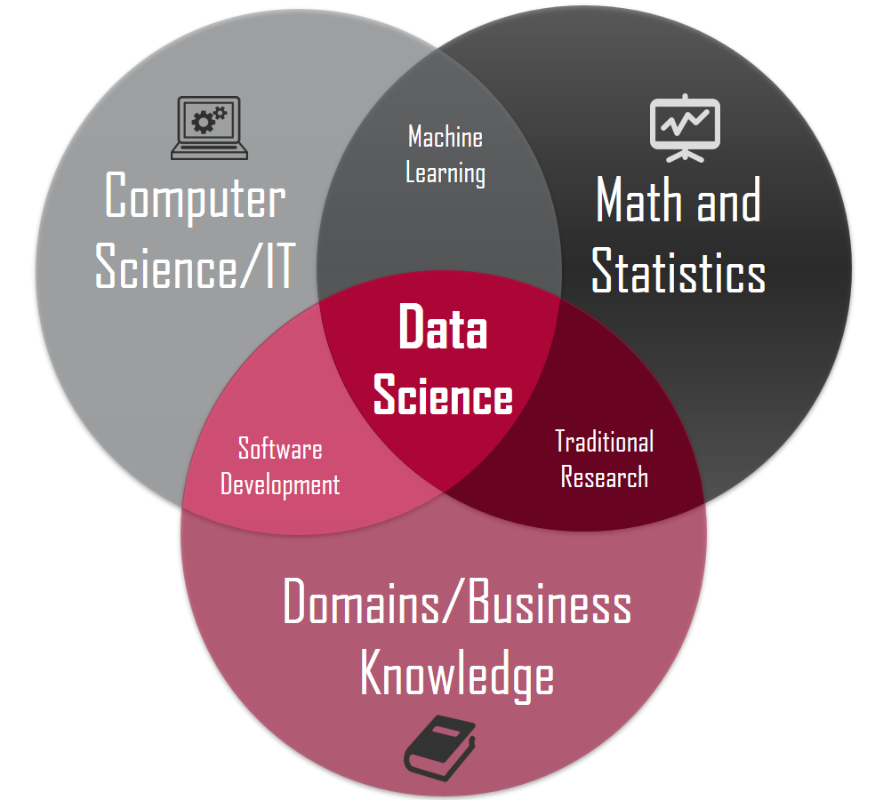
What is Data Science
An automated way to extract, process, analyse Enterprise data from various different data sources
Provides Insights that are not obvious
Helps Organizations to strategize future business by looking at past patterns
Leverages the power of Statistics + Mathematics + Programming + Big Data + Visualization

Slide 9
Data Science – What Makes it Work?
Data Science
Domain Expertise
Programming Skills
Statistics & Math
Problem Solving Mindset
Data Engineering Skills

Slide 10
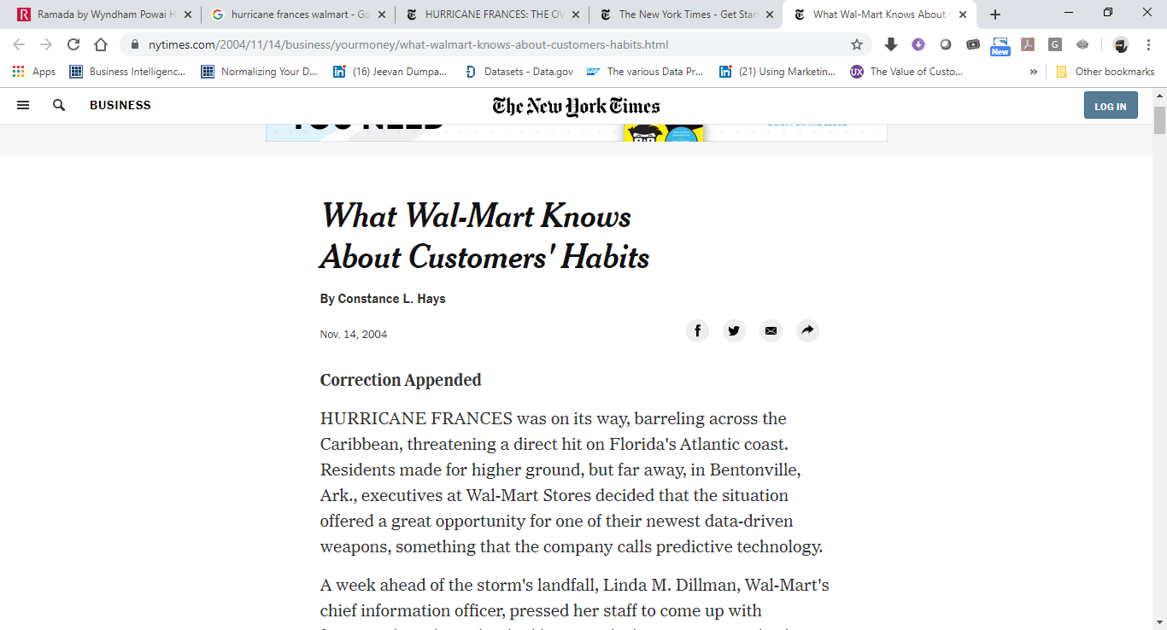
Importance of Data Science – Via an Example
In 2004, Hurricane Frances was threatening a direct hit on Florida Coast. While govt. had made efforts to shift residents to higher ground, Wal-Mart was making some other preparations
For them, the situation presented a great opportunity for predicting what products would be bought more by customer.
WalMart’s data scientists came up with forecasts based on prior hurricanes that hit the coast by analysing billions of data points on shopper history
What transpired as products that Customers wanted was totally surprising. Past Data mentioned to them that instead of just the usual flash lights products like “Strawberry Pop-Tarts”, showed 7 times increase in sales ahead of a prior hurricane than normal.
Based on this they increased the inventories of pastries and six packs
https://www.nytimes.com/2004/11/14/business/yourmoney/what-walmart-knows-about-customers-habits.html

Slide 11
What does Wal-Mart case teach us
Its very normal to think that during a Hurricane, flash lights and water bottles are needed
It begs to ask a question, then why data science or stats for telling the obvious
A deeper understanding of Data has revealed the true customer behavior to Wal-Mart
Statistics helps in unearthing information that is not OBVIOUS
You KNOW What the Pre Hurricane Top Selling Item was???
BEER !!!!!

Slide 12
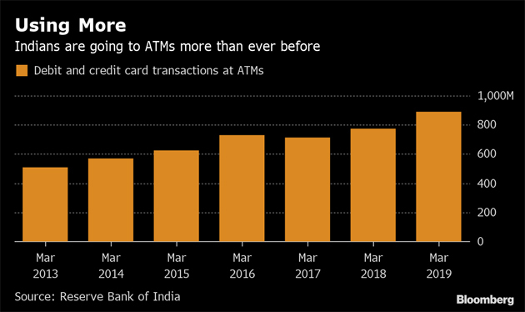
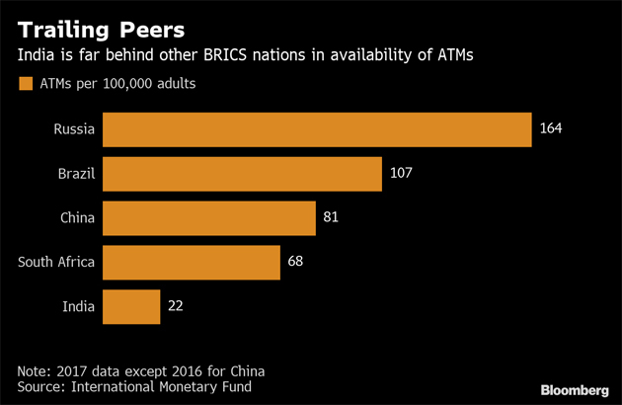
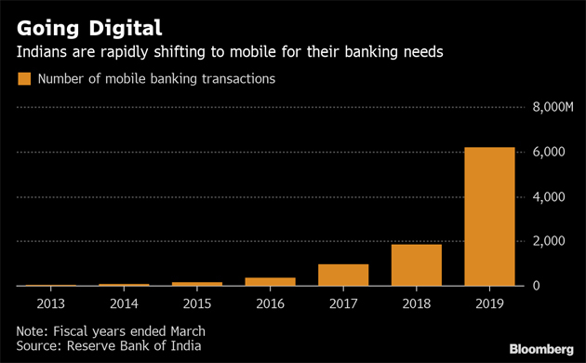
Why Data Science – Example- ATM Usage in India
Without Help of Statistics, it would be very difficult to un earth such information and summarize them in such detailed manner
Excepts from
https://economictimes.indiatimes.com/industry/banking/finance/banking/india-is-shutting-down-atms-even-as-people-use-them-more/articleshow/69335621.cms

Slide 13
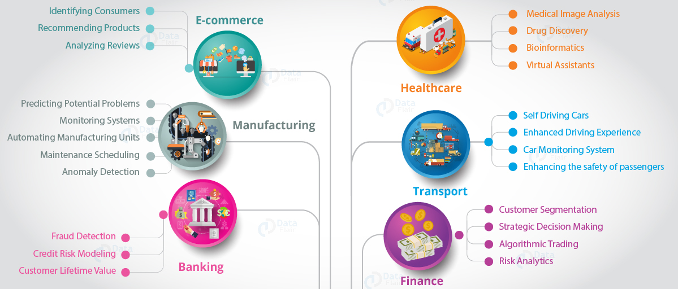
Applications of Data Science

Slide 14
Other Applications of Statistics In Enterprises
Statistical Analysis can be applied to a wide variety of use cases across diverse domains. Some examples are
Marketing research Firms analysing consumer spend patterns to suggest new products and strategize new advertising campaigns
Workforce optimization at Enterprises
Product Quality Assurance in Manufacturing Industries
“Fund Houses” apply statistics to find out types of securities that can be held in its investment portfolio
Identify profitable trade opportunities
Statistical analysis primordial need is to explain real-world events

Slide 15
Data Science In Enterprises – Who is it for?
Data Science in Enterprises(who is it for?)
Business Analysts
Developers
Testers (Functional + Automation)
Program management
Risk and compliance
Solutions Architecture (Tech + Data + Information)
Info Security (cyber security)
Production Support
“C” Level Team
Improving decision-making — data science gives management actionable intelligence that leaders can use to shape short- and long-term strategies.
Improving hiring — data science can help more objectively evaluate candidates and root out inefficiencies and biases.
Predicting the future — using machine learning algorithms, data scientists can find patterns in data that humans would not be able to, and forecast future results with a higher level of accuracy.
Improving targeting — data science can help companies find new target markets, better understand existing customers, and more accurately predict what customers want.
Identifying new opportunities — by exploring data and looking for patterns, data scientists can identify new business opportunities that might not otherwise be apparent.
Improving risk assessment — data science often makes it possible to “test” risky ideas by running the numbers before putting them into action, allowing companies to avoid potentially costly risks and mistakes.
Fostering data-first culture — a data scientist or data science team can help facilitate data-based decision-making in every team across the company by providing them with data tools like dashboards and the training necessary to understand them.

Slide 16
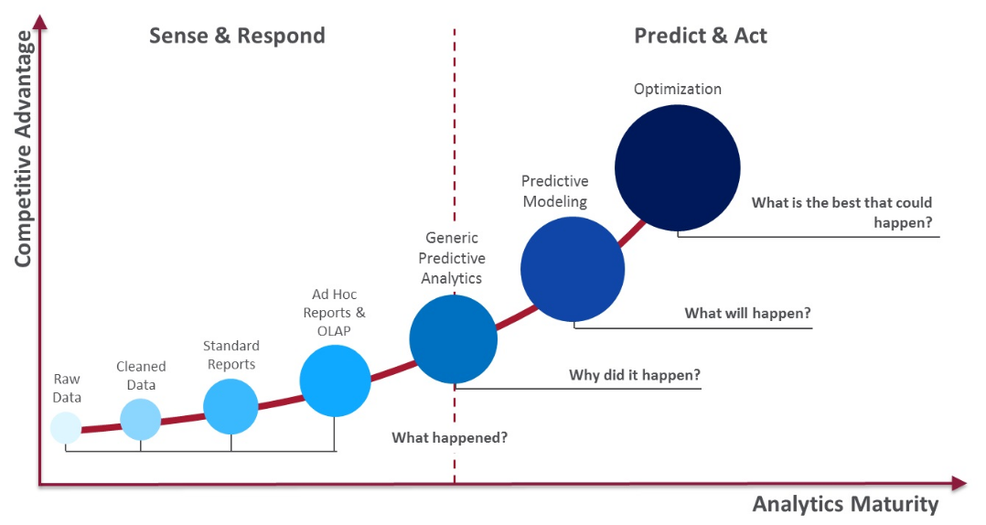
Data Maturity in Organizations

Slide 17
Data Maturity In Organizations - Data Science In Orgs
Machine Learning
Supervised/Unsupervised/Reinforcement
Deep Learning
ANN/CNN/RNN
NLP
Recommender Systems
Collaborative Filtering/Content Based Filtering
Reinforcement Learning
Computer Vision
Prescriptive
Analytics
Predictive Analytics (What will Happen)
Basic Reporting
Diagnostic Analytics(Why it Happened)
Descriptive Analytics (What Happened?)
Business Intelligence
A
N
A
L
Y
T
I
C
S
Preventive , Corrective Actions
Recommendations
Statistics + Descriptive Analytics + Diagnostic Analytics + Business know how + Technology
Prepares an organization for future strategies
Artificial Intelligence
Statistics + Domain + Technology
Focuses on finding the root cause
Also called Inferential stats
Uni variate and bi variate analysis for data exploration and inferences
Stat techniques
Statistics + Domain + Technology
Uses Statistics/Domain to confirm that a problem happened
Helps identify problems in data
Even with minimal business knowledge
Data Ingestion
Data Cleansing(Wrangling)
Data Preparation
Statistical techniques (sampling,Hypothesis,Normality etc)
Data Scientists should be strong at ingestion, transformation, exploration. All in One
Insights are very effective because of statistics
Powerful Tools that covers the entire journey
Ability to bring together data from different data sources
Helps Data Mining via queries
Reports can be self served by Users
Users need not be technically savvy and focus only on business
Data Warehouses - Data Persistence
ETL/ELT – Data Extraction /Transformation/Load
Reports /OLAP – Cognos /MicroStrategy
SME Dependency
Can promote silos between DW Speacialists + Reporting Specialists + Business Analysts
Development time of BI Models and introducing changes can be higher.
BI Architects are more technical than functional
report transactional data over time periods. Typically has header, detail, trailer
Hourly, daily , monthly, quarterly, half-yearly, yearly reports
A good tool for a SME to understand the trend
Typical reports, sales revenue, accounts finance, transaction logs etc..
Excel reports
Table Query outputs
No visualizations
Longer development time with technical challenges
Heavily dependent on SMEs to interpret the data.
Gives a siloed view of business, enterprise view is very difficult to bring in
Not “C” level friendly

Slide 18
Learning models
Classification
Regression
Solves problems that humans are good at , Natural Language, Image recognition, Speech Recognition etc
Neural
Networks
Machine learning
AI
Deep learning
Artificial General Intelligence/Narrow AI
Supervised/Unsupervised/Reinforcement

Slide 19
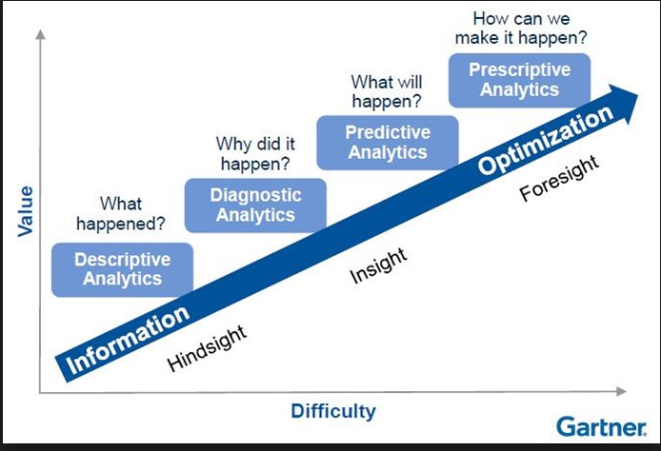
Analytics Maturity in Organizations

Slide 20
Data Science Project Life Cycle
Python
Pandas
Numpy
Train/Test Split
Sci-Kit Learn
Model Fitting
Sci-Kit Learn
Model Prediction
Sci-Kit Learn
Model Visualization
Matplotlib
Seaborn
Python
Pandas
Numpy
SQL
1.
Data Discovery
2.
Data Ingestion
3.
Data Wrangling(Pre-Processing/
Preparation)
4.
Data
Exploration
5.
Model Selection &
Model Building
6.
Model
Evaluation
7.
Model
Comparison
8.
Model
Boosting
9.
Explainable
Machine Learning
Data Analysis
Python
Pandas
Numpy
Data Visualization
Matplotlib
Seaborn
Python
Pandas
Numpy
Model Metrics
Sci-Kit Learn
Model Visualization
Matplotlib
Seaborn
Python
Pandas
Numpy
Model Visualization
Matplotlib
Seaborn
Python
Pandas
Numpy
Sci-Kit Learn
Model Visualization
Matplotlib
Seaborn
Python
Pandas
Numpy
Sci-Kit Learn
Model Visualization
Matplotlib
Seaborn
Python
Kafka
NiFi
Spark
Python
Pandas
Numpy
Spark
Define Problem statement Requirements
Assess Data Sources
Identify Key Business fields for Sampling
Assess Data Sources
Batch Extract thru ETL (Extraction Transformation Load)
Real Time Extract thru Kafka/Ni Fi Spark
Data Cleansing
Remove Missing Values
Remove Outliers
Data Imputation
Data Manipulation
Rename Columns
Data Summarization
Data Fitering Sorting/Grouping
Merge/Join/Concat
Univariate Analysis
.info()
.describe()
Barplots,histogram,
Count plots
Bi Variate Analysis
Scatter Plot
.Corr
Correlation Plot
Regression Plot
Visualization
Actual Vs Predicted
Write up on corrective and preventive actions
Dashboards /Stories on current performance
Evidence on data anomalies and way to correct .
Model Selection/Fitting - Fit model on Training Data
Derive Correlation / Derive Independent & Dependent variable
Prepare Train and Test Data
Decide on Supervised/UnSupervised learning
Decide on Classification/Regression for supervised
Decide on Clustering or dimension reduction(pca) for unsupervised
Fit the data for Multiple model techniques
If classification – Logistic Reg/Random Forest/Decision Tree/KNN/NB/SVM etc
If regression – Linear Regression/Random Forest/Decision Tree/KNN..etc
Model Prediction - Predict on Test Data
Model Evaluation - Measures performance of Model
Model Comparison - Compares performance of different model techniques
Model Boosting - Boost the performance of chosen model
Move to Prod – Move the model to production as a .pkl file

Slide 21
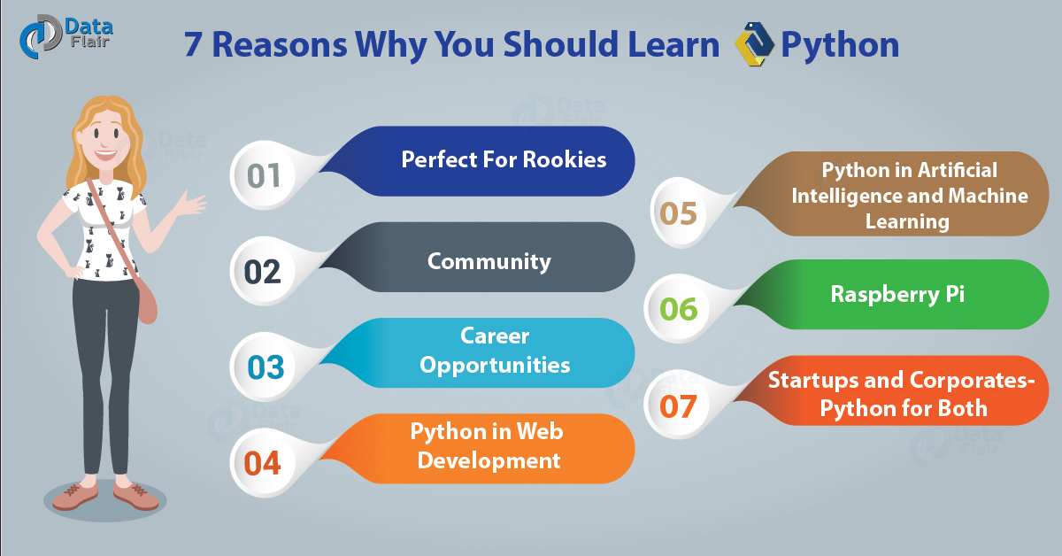
Why Python
Large corporates like Google Uses Python for a number of their applications
Active Support community
Big Data and Cloud Friendly Language
Great Libraries for faster development. Numpy,Scipy, Pandas for analytics and computing. Django for web development
Great support for ML and AI
Accessible, easy

